Slide 1
Calculus
Derivatives

Slide 2
Outline
Definition and Notation
Single Variable Example
Partial Derivatives
Two Variable Example

Slide 3
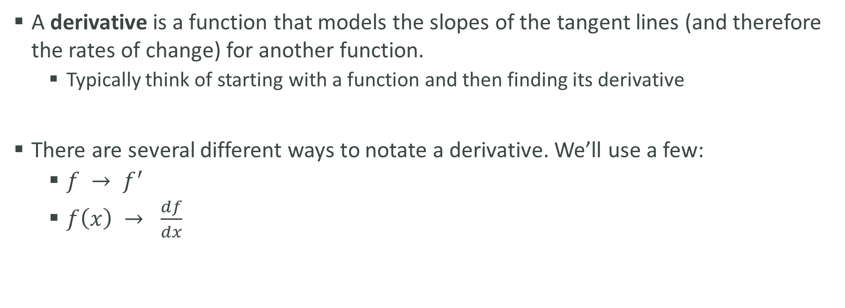
Definition and Notation
A derivative is a function that models the slopes of the tangent lines (and therefore the rates of change) for another function.
Typically think of starting with a function and then finding its derivative
There are several different ways to notate a derivative. We’ll use a few:
$f → f^{′}$
$f\left(x\right) → \frac{df}{dx}$

Slide 4
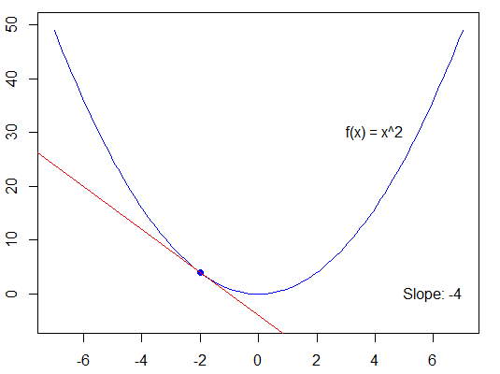
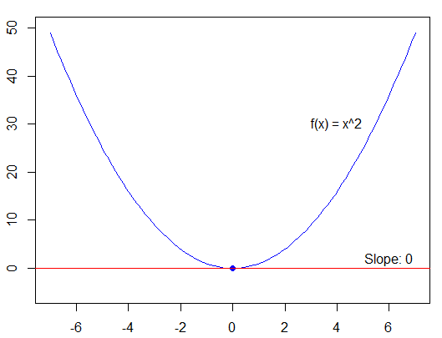
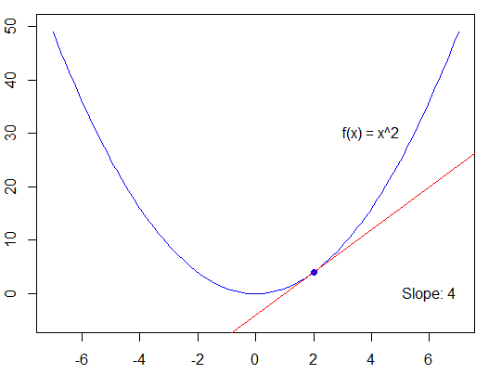
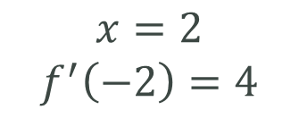
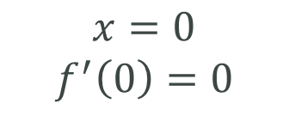
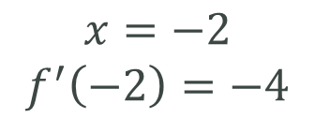
Single Variable Example
Consider again $f\left(x\right)=x^{2}$ and let’s look at the slope of its tangent lines at $x=−2, 0, 2$.
$$x=−2$$
$$f^{′}\left(−2\right)=−4$$
$$x=0$$
$$f^{′}\left(0\right)=0$$
$$x=2$$
$$f^{′}\left(−2\right)=4$$

Slide 5
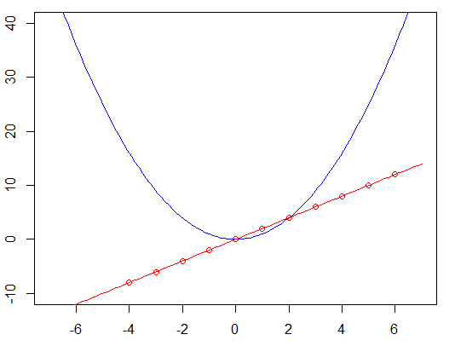
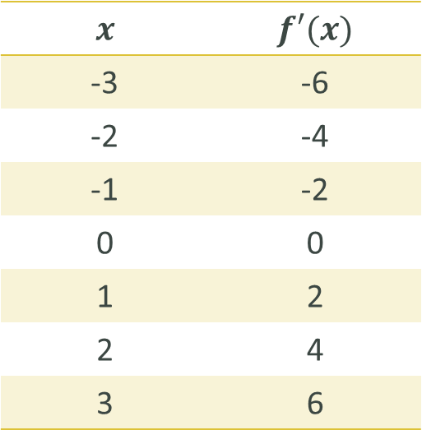



Single Variable Example
Pulling together several values of $x$ and $f’(x)$allows us to plot the derivative and see its shape.
$$f\left(x\right)=x^{2}$$
$$x$$ | $$f′(x)$$
-3 | -6
-2 | -4
-1 | -2
0 | 0
1 | 2
2 | 4
3 | 6
$$f′\left(x\right)$$

Slide 6
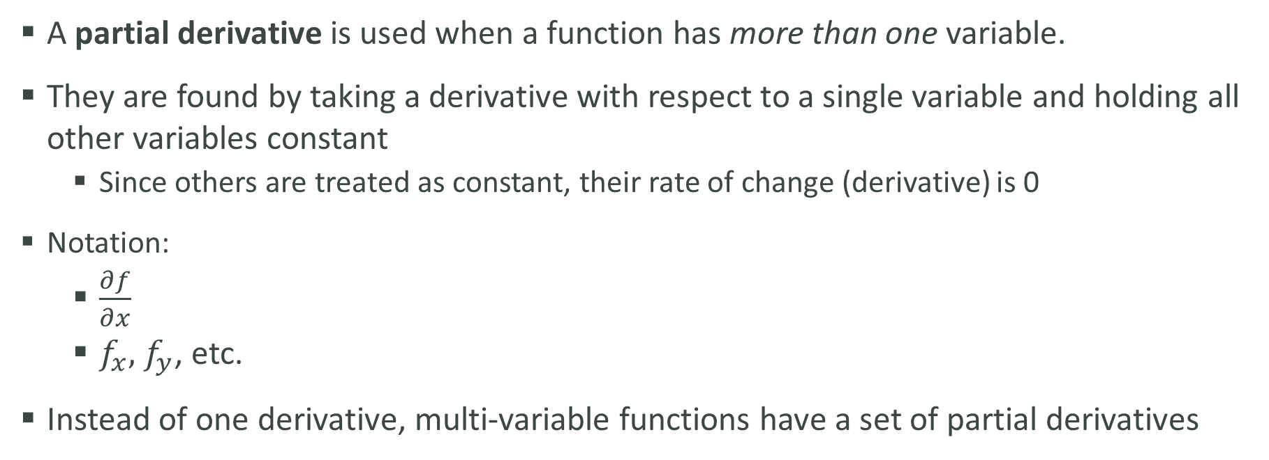
Partial Derivatives
A partial derivative is used when a function has more than one variable.
They are found by taking a derivative with respect to a single variable and holding all other variables constant
Since others are treated as constant, their rate of change (derivative) is 0
Notation:
$\frac{∂f}{∂x}$
$f_{x},$ $f_{y}$, etc.
Instead of one derivative, multi-variable functions have a set of partial derivatives

Slide 7
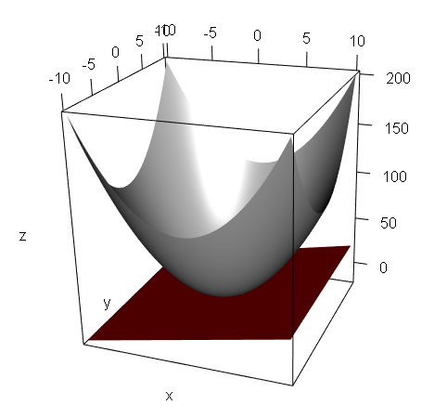
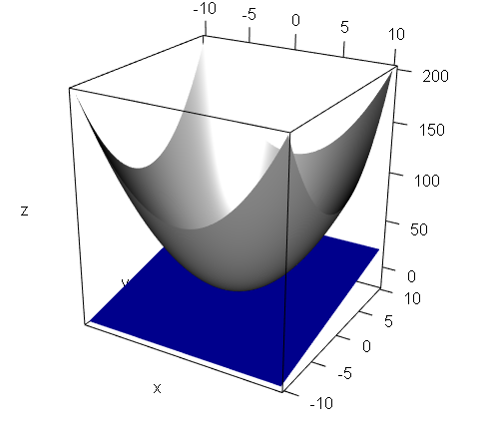
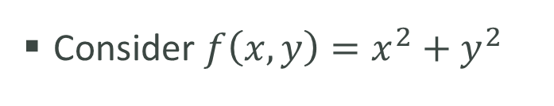


Two Variable Example
Consider $f\left(x,y\right)=x^{2}+y^{2}$
$$f_{x}$$
$$f_{y}$$

